Slide 1

Attendance Workshop
Friday 21st March 2025

Slide 2
The law entitles every child of compulsory school age to an efficient, full-time education suitable to their age, aptitude, and any special educational need they may have. It is the legal responsibility of every parent to make sure their child receives that education either by attendance at a school or by education otherwise than at a school.
Where parents decide to have their child registered at school, they have an additional legal duty to ensure their child attends that school regularly. This means their child must attend every day that the school is open, except in a small number of allowable circumstances such as being too ill to attend or being given permission for an absence in advance from the school.

Slide 3
It is essential for pupils to get the most out of their school experience, including their attainment, wellbeing, and wider life chances.
The pupils with the highest attainment at the end of key stage 2 and key stage 4 have higher rates of attendance over the key stage compared to those with the lowest attainment.
At KS2, pupils not meeting the expected standard in reading, writing and maths had an overall absence rate of 4.7%, compared to 3.5% among those meeting the expected standard.

Slide 4
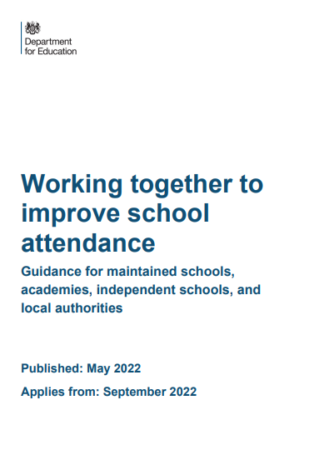

Slide 5

An attendance rate of 95% is generally considered good; this allows for children to miss 9.5 days across the school year.

Slide 6
Persistent absence refers to pupils who miss 10% or more of school
Severe absence refers to pupils who miss 50% or more of school.

Slide 8
Schools must:
Have a designated senior leader with overall responsibility for improving attendance
Set high expectations for the attendance and punctuality of pupils and communicate these regularly to pupils and parents

Slide 9
Schools must:
Contact parents on the first day of absence where a reason hasn't been provided and continue doing so where needed to ensure safeguarding
Review absences that are not explained for each session and contact parents to find out the reason why, and when the pupil will return
Regularly inform parents about their child’s attendance and absence levels
Hold regular meetings with parents of pupils considered to be vulnerable or those that are persistently or severely absent

Slide 10
School Responsibilities
In the first instance school is expected to support pupils and parents by, for example:
Working together to understand and address any in-school barriers to attendance
Meeting with those at risk of persistent or severe absence and agreeing actions or interventions to improve the situation
Making referrals to services and organisations that can provide support
Where absence intensifies, school is expected to provide additional support, such as:
Holding more formal conversations with the parents and pupils
Working with your local authority (LA) and other relevant partners

Slide 11
Where a pupil is persistently absent, the DfE expects schools to also:
Put additional targeted support in place to remove any barriers
Work with the LA on legal intervention where support is not working or being engaged with
Intensify support through statutory children's social care, where there are safeguarding concerns

Slide 12

At high school, children who have had poor attendance during their school career are more likely to drop out; often due to underachievement and or problematic friendships. They are 3-6 times more likely to become involved with the police either as perpetrators or victims of crime.
Children who attend school regularly build up more resistance to minor illnesses; some parents will find they need to raise the threshold a little as a child transfers from Nursery to Reception to meet the schools attendance expectations.
Interacting with children as part of their daily routine at school is absolutely essential for their mental, social and emotional development. Today, a huge number of children are starting school at a series disadvantage because of underdeveloped communication difficulties.

Slide 13

Reasons for absence:
Illness:
Chronic and acute (pupil)
Sporting
Religious Observance
Holiday
Anxiety

Slide 14

Lateness
Your child starts working as soon as they come into their classroom in the morning.
If your child is just 5 minutes late every day, then they could be missing out on 25 minutes of learning a week: Over a typical 6 week term, this would be 150 minutes – that’s 2½ hours learning time! In the course of a school year (31 weeks) this would rise to 775 minutes, or nearly 13 hours
Just imagine if you are always 10 minutes late…..that could be nearly 26 hours of missed learning!

Slide 15

PENALTY FINES
On the 19th August, penalty fines increased to £160 payable within 28 days, reducing to £80 if paid within 21 days. Notices can be issued per parent, per child. For example if two siblings are absent, each parent would receive two fines. This is a total of £640.
Missed Sessions - Being late after registration for 10 sessions in 10 weeks, or being collected early can result in a penalty notice.

Slide 16

Top Tips
Know the timetable. Ensure PE kit or homework is packed up the night before to avoid running around. Prep uniform in advance.
Get into the habit of doing homework in the evening to avoid morning stress
Have a healthy bedtime routine
Allow plenty of time for your journey
Talk to the team, teachers, Learning Support Assistants, Office, Senior Leaders. We are all here to help!

Slide 17
Questions

