Slide 1

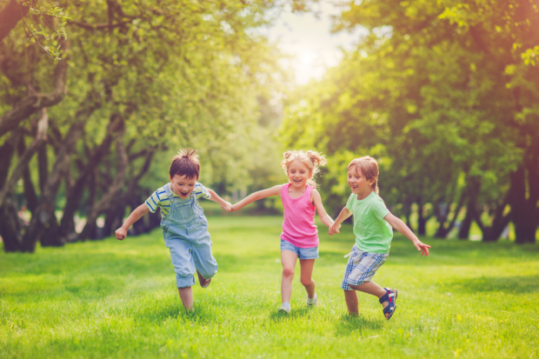


Drayton Green Parent Workshop
Relationships & Health Education
Notes:
Welcome to the Parent Workshop for Relationships and Health Education
We’re trying something new this year – a video presentation, rather than in-person workshops

Slide 2


Aims
Relationships and Health Education (RHE) in primary schools
The importance of RHE in primary schools
Curriculum content
Notes:
In this video I am going to talk a little bit about Relationships and Health Education in general
What it is, why it is important that we teach it
And then look at the lessons that your child will be taught.
Beneath this video, you will find links to all the resources that your child will see during RHE lessons. No videos or books will be used, other than these resources.

Slide 3



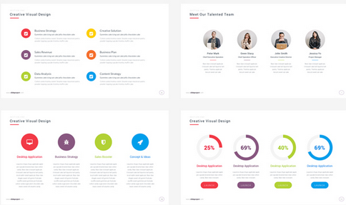
Meet the Health Improvement Team
Why teach RHE in school?
Notes:
3

Slide 4
My Relationship and Health Education
Pause the video and think about the information you had about growing up.
Did you get it from:
Your parents?
School lessons?
Your friends?
Magazines or books?
What was good? Did it help? What would you change?
Notes:
I invite you to take a moment to cast your mind back - what experiences and memories you have of growing up – whether here in London, somewhere else in the UK, or perhaps in a different country or continent.
How did you learn about growing up – was it from your parents, did you get lessons about it, was your main source of information your friends or did you decide it was best to read about it in magazines and books?
Whichever way you found out about growing up, you might want to pause this video and think about whether your experience was positive – did you learn everything you needed to know about, were you able to ask questions, did you feel prepared for the changes of puberty?
Or was the information you were given incorrect, worrying, inappropriate even?
What would you have changed?

Slide 5
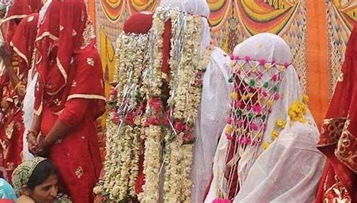
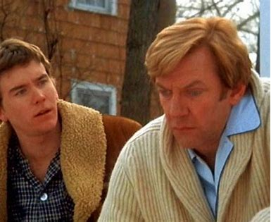
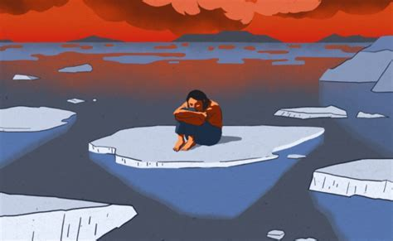
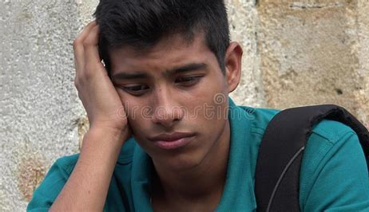
Adults tell us….
“I was frightened”
“I was worried”
“Am I normal”
Notes:
As adults we may have had fears and worries growing up…

Slide 6
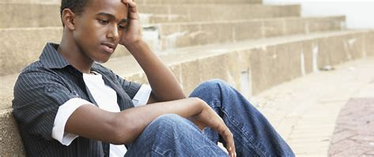

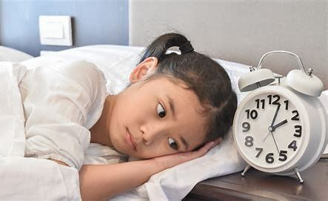
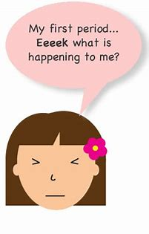
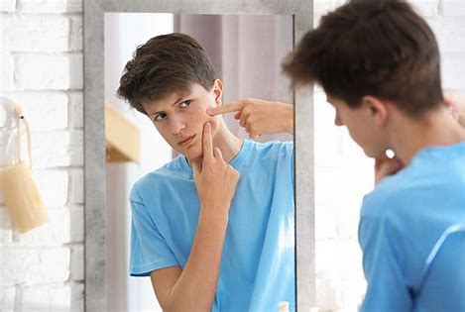
Children tell us….
“I’m worried”
“I’m frightened”
“Am I normal”
……the same
Notes:
…and so do children.
The feelings of those going through puberty and adolescence are not so different to the ones you and I will have experienced growing up.
Accurate, informative RHE education delivered at an age-appropriate level will help your child steer their way through changes which can cause confusion and uncertainty.
Because…

Slide 7
Where do children and young people learn?
TV Adverts Social Media
Music Gaming Parents
Siblings Peers School
Youtube Disney Films
Notes:
Our children are exposed to so much though social media, films and music – there are so many voices telling them what a man or a woman should be, or what relationships should look like.
We want to work with parents so that together we can be the loudest voice, the clearest voice.
We want our children to know that if they come to us, or they come to parents, they will get the same message, a message they can trust, and that will help to grow up to be healthy, happy adults.

Slide 8

Ofsted Review into Harmful Sexual Behavior in Schools
RSHE as part of the solution
Following the deaths of Sara Everard and Sabina Nessa in 2021, there was a greater focus on protecting girls and women from violence and harm.
Ofsted were asked to review the extent of ‘peer-to- peer’ sexual abuse or Harmful Sexual Behavior in schools in.
They were to consider the safeguarding protocols and how RHE could be used to tackle the issue as part of a whole school approach.
Consent and healthy relationships are paramount to an effective RHE curriculum.
Notes:
When children grow up without good quality RHE education from schools and from parents, when they grow up not knowing what a healthy relationship looks like, or how to talk about things that are worrying them,
then this leaves them vulnerable in their teenage and adult lives.

Slide 9
RHE and safeguarding
Universal language spoken by all
CSE and grooming – links to online safety
Appropriate and inappropriate touch
Promotes healthy relationships
Notes:
Schools and parents have many common goals, but first and foremost is making sure that children grow up safe.
RHE lessons give children a language and voice to speak up if they are worried about things, or have questions.
RHE lessons help children know what safety feels like and what do if they don’t feel safe online or in real life.
It helps them understand behaviours which are appropriate or inappropriate for themselves
It helps them know that they deserve to grow up to have happy and health relationships.

Slide 10
What can you do at home?
Invite discussion and questions
Find out what is being covered in school
Use books or online resources
Normalise growing up and puberty
Notes:
What can you do at home?
Well, first of all, make sure children know that they can always come to you if they have worries, concerns or questions. The surest way to keep our children safe is by teaching them they will always be listened to by mum and dad.
Look through the resources that your child’s teacher will be using in RHE lessons
And use these – or other resources online or in books - to help support conversations with your child.
And finally - talk positively about the changes your child will go through as they grow and develop. Make sure they understand that questions and worries are normal, but that ultimately this is an exciting part of their lives.

Slide 11


What is Relationships and Health Education?
Notes:
So, what does RHE - relationships and health education – actually look like?

Slide 12
What is RHE?
RHE stands for:
    Relationships
    Health
    Education
RHE forms part of the PSHE (personal, social, health and economic) curriculum.
Lessons about keeping safe, good and bad touch, people who help us, good friendships and peer pressure are taught throughout the year.
Specific RHE lessons are usually taught in Summer Term.
Notes:
RHE stands for:
Relationships
Health
Education
RHE forms part of the PSHE (personal, social, health and economic) curriculum.
Some aspects of RHE are taught throughout the year.
Two or three Specific RHE lessons are taught in each year group in the Summer Term

Slide 13
Schools have been teaching Relationships Education for many years.
All Ealing primary schools deliver the same curriculum
Content is age appropriate and child friendly
Notes:
Schools have been teaching Relationships Education for many years.
The curriculum we deliver is taught in all Ealing schools
Each year group covers different Content which is age appropriate and child friendly – with children being prepared for each next step in their own development.
So what is covered?

Slide 14
Relationships Education
Families and people who care for me
Caring friendships
Respectful relationships
Online relationships
Being safe
Notes:
Relationships Education puts in place the building blocks needed for positive and safe relationships, including with family, friends and online. Your child will be taught what a relationship is, what friendship is, what family means and who can support them. In an age-appropriate way, we will cover how to treat each other with kindness, consideration and respect.
By the end of Primary school your children will leave to go to high school having been taught about
Families and people who care for me
Caring friendships
Respectful relationships
Online relationships – this doesn't mean romantic relationships, but rather any interaction with others online
Being safe

Slide 15
Health Education
Mental wellbeing
Internet safety and harms
Physical health and fitness
Healthy eating
Drugs, alcohol and tobacco
Health and prevention
Basic first aid
Changing adolescent body
Notes:
And in health education, children will be taught…
Please note, children are only taught about the changing adolescent body from Year 4 onwards

Slide 16
Meet the Health Improvement Team
What will be my child(ren) be taught?
Notes:
16

Slide 17
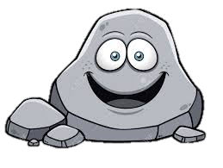
Ground Rules
R - Respect
O – Openness
C – Confidential
K - Kind
Notes:
Each lesson begins with these ROCK rules, to ensure that children focus on RHE in a respectful, calm manner.
Confidential here means that the topic isn’t one to be discussed in the playground. However, teachers make it clear that there is nothing rude or private about lesson content, and that everything can and should be discussed with parents at home.
We make it clear – there should be no secrets from mum and dad. This is another way to make sure children learn to keep safe.

Slide 18
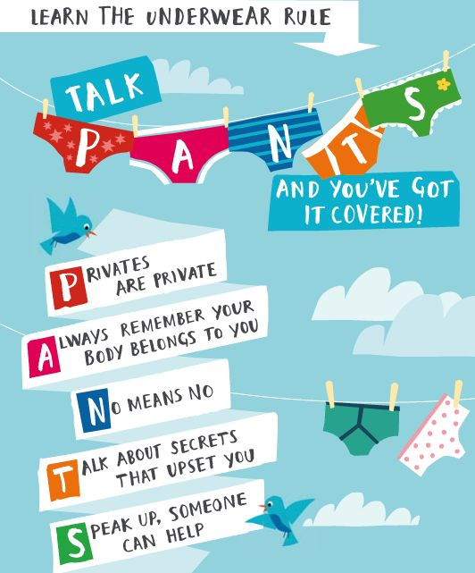
RSHE as part of the solution
The ‘PANTS’ rule is a critical way to begin conversations around consent and personal boundaries.
By consistently reinforcing these messages with age appropriate context expanded on, we are equipping young people with the tools necessary to navigate their relationships.
Notes:
Every year from Nursery to Year 6, all PSHE lessons also begin with the NSPCC PANTS rules.
These are rules which put some quite difficult concepts into simple words to allow children to understand them.
Yet another way we teach children to stay safe, and to share worries or concerns that upset them.

Slide 19
Year 1
Summer 1 – What is personal safety?
Lesson 1: What is hygiene? How does it keep us healthy?
Lesson 2: How do I keep safe at home?
Lesson 3: How do I keep safe outdoors?
Lesson 4: What is the PANTS Rule (EYFS recap)
Lesson 5: What are different types of touch?
Lesson 6: Who keeps me safe?
Notes:
We are now going to look at the RHE lessons which will be taught in each year group.
The specific RHE lessons which we have discussed in this video are highlighted in red. The resources for these lessons are linked below this video.
Feel free to skip ahead to the year group that is most relevant to you.

Slide 20
Year 1
Summer 2 – What do we have in common?
Lesson 1: What makes a family?
Lesson 2: What is the same and different about all of us?
Lesson 3: How can I treat others kindly?
Lesson 4: What happens if people are treated unkindly?
Lesson 5: What will I take away from PSHE?

Slide 21
Year 2
Summer 1 – How does being safe make me feel?
Lesson 1: What happens when I sleep?
Lesson 2: How can being online effect my health?
Lesson 3: What things do I need to make time for?
Lesson 4: What body parts belong to me
Lesson 5: How do different types of touch make me feel?
Lesson 6: Risks, unsafe events and emergencies

Slide 22
Year 2
Summer 2 – How do I recognize risk?
Lesson 1: What makes a family?
Lesson 2: What is the difference between a secret and a surprise?
Lesson 3: How do I keep myself safe in different places?
Lesson 4: How do I help some in need (basic first aid)?
Lesson 5: What will I take away from PSHE?

Slide 23
Year 3
Summer 1 – How do I keep my body safe?
Lesson 1: What are allergies?
Lesson 2: How do I manage other types of health issues?
Lesson 3: What body parts belong to me?
Lesson 4: How do I keep my body private? (PANTS)
Lesson 5: How do different cultures celebrate growing up?

Slide 24
Year 3
Summer 2 – Who is there to help me when I recognise risk?
Lesson 1: How can families be different?
Lesson 2: How do we manage pressure from friends? 'doing dares'
Lesson 3: Who keeps me safe in different places?
Lesson 4: How do I contact the emergency services?
Lesson 5: What will I take away from PSHE?

Slide 25
Year 4
Summer 1 – What changes happen as I grow up?
Lesson 1: What is a healthy brain?
Lesson 2: What is the life cycle? How do we change?
Lesson 3: What physical changes happen as we grow up?
Lesson 4: What is the menstrual cycle?
Lesson 1: What is gender equality?

Slide 26
Year 4
Summer 2 – What can I do about risks?
Lesson 1: What makes a family unique?
Lesson 2: What is the difference between a positive risk and a dangerous behaviour?
Lesson 3: What risks are there when I am in different places?
Lesson 4: How do I react when someone is hurt?
Lesson 5: What will I take away from PSHE?

Slide 27
Year 5
Summer 1 – What can I expect during puberty?
Lesson 1: What helps our bodies and what harms our body?
Lesson 2: What are hormones?
Lesson 3: What physical changes happen in puberty?
Lesson 4: What emotional and social changes happen during puberty?
Lesson 5: What happens after adolescence? What choices do we have as we become young adults?

Slide 28
Year 5
Summer 2 – How do we respond to change, risk and harm?
Lesson 1: How can families change?
Lesson 2: How is an online relationship different to real life?
Lesson 3: How to identify risks in different places and how do I respond?
Lesson 4: How can I save a life?
Lesson 5: What will I take away from PSHE?

Slide 29
Year 6
Summer 1 – How is my body preparing for adulthood?
Lesson 1: What choices are there around substances as I grow up?
Lesson 2: What is mental illness and addiction?
Lesson 3: Why does the body change during puberty?
Lesson 4: How does our body change for reproduction?
Lesson 5: How do we stay healthy as we age? (Dementia)

Slide 30
Year 6
Summer 2 – How do relationships change as we grow up?
Lesson 1: How do we show love, care and commitment to others? (Marriage and Long Term Relationships)
Lesson 2: What pressures may we face online in our relationships as we grow up?
Lesson 3: How can I help others in an emergency?
Lesson 4: What will I take away from PSHE?
Lesson 5: What advice would I give to the Year 5's?

Slide 31

Thank
you for watching!
Notes:
Please spend some time looking through the linked resources below. Remember, these are the resources we will use to teach your children, no additional books or videos will be used.
I hope you found this video useful. If you have any questions, please speak to your child’s
31

